Slide 1
Project 1 - Standardized Test Analysis
ACT and SAT Analysis
GA DSI 33
Florian Combelles

Slide 2
Background and Datasets
ACT and SAT are standardized tests that many colleges and universities in the United States require for their admissions process.
This score is used along with other materials such as grade point average (GPA) and essay responses to determine whether or not a potential student will be accepted to the university.
For this analysis, we will be using 10 datasets comprising of participations rates and scores for each American state for both ACT and SAT exams.

Slide 3
Problem Statement
You, the US Ministry of Education, have appointed us to advise you on the impact of Covid and States choosing to go Test Optional in regards to the participation and scores of ACT and SAT exams.

Slide 4
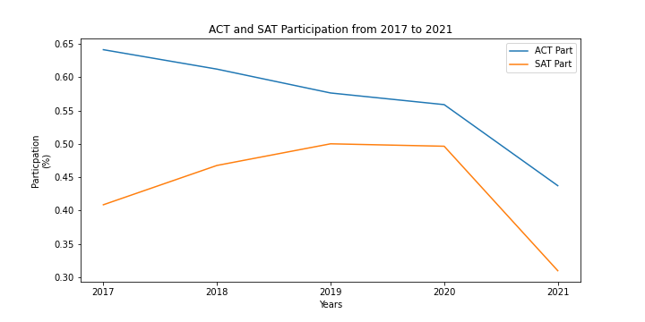
Participation Analysis
Has Covid impacted the participation rates of ACT and SAT
ACT participation dropping since 2017
Sharp decline in 2020 and 2021
SAT participation increasing since 2017
Sharp decline in 2020 and 2021

Slide 5
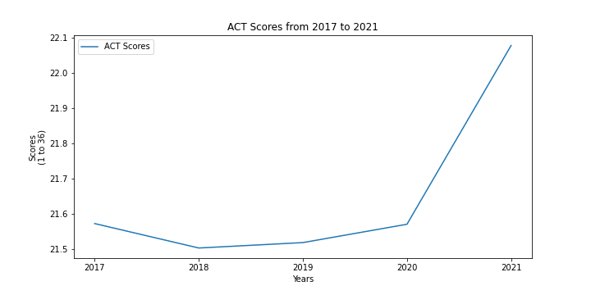
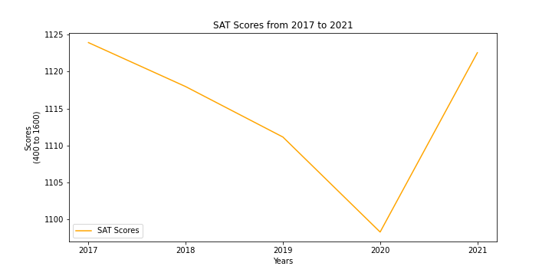
Scores Analysis
Has Covid impacted the scores of ACT and SAT
ACT scores have been increasing since 2018
Significant increase in 2020 and 2021
SAT scores have been decreasing until 2020
Significant increase in 2020 and 2021

Slide 6
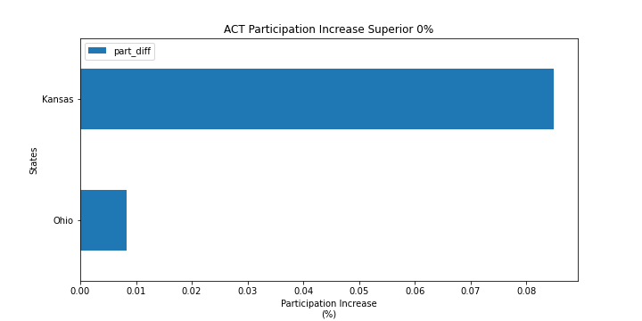
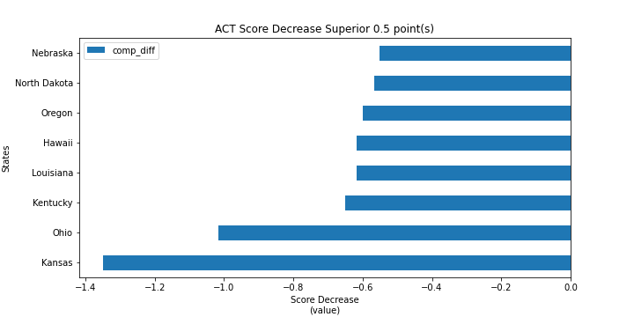
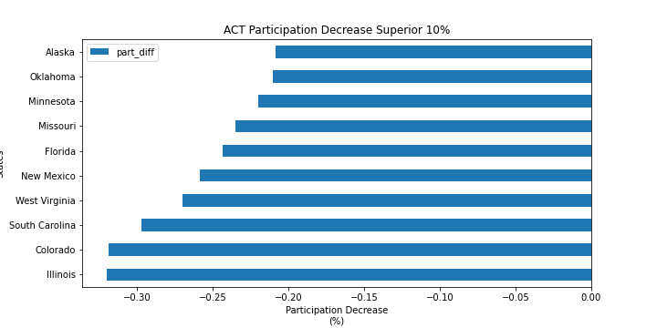
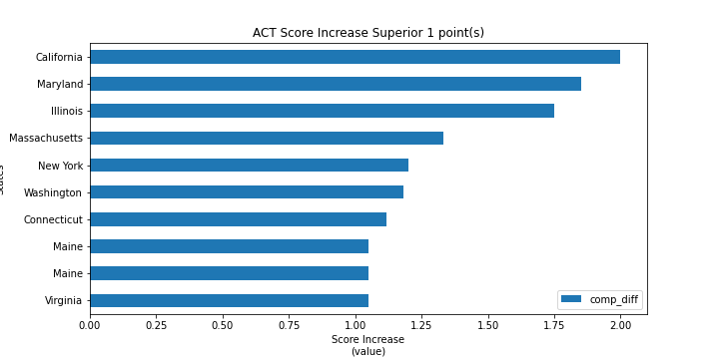
Participation effects on scores
Does a change in ACT participation rate impact the scores
Participation increase
=
Score decrease
Participation decrease
=
Score increase

Slide 7
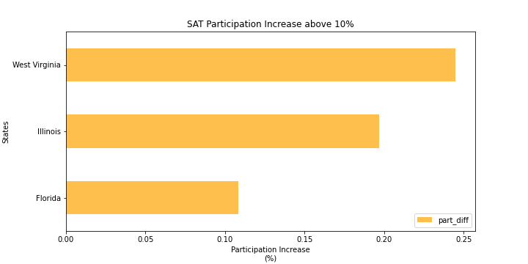
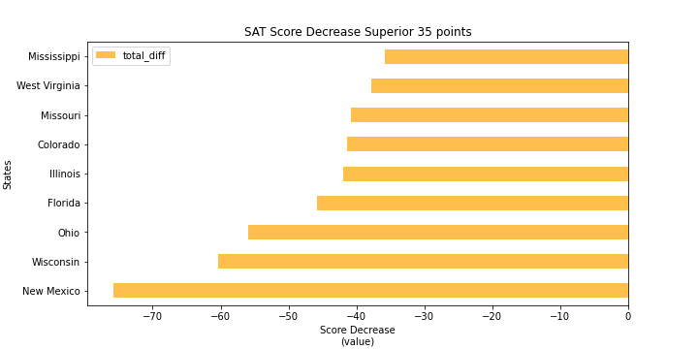
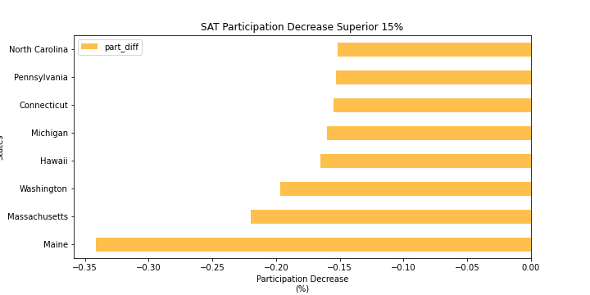
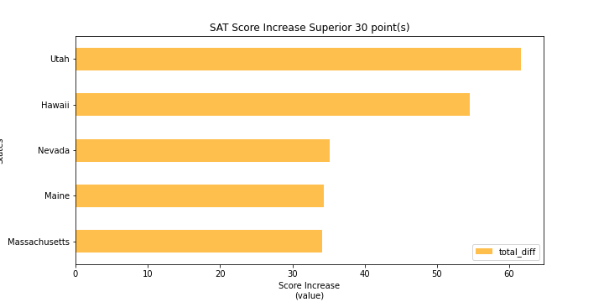
Participation effects on scores
Does a change in SAT participation rate impact the scores
Participation increase
=
Score decrease
Participation decrease
=
Score increase

Slide 8
Participation affects inter-exam
Does a change in participation rate in one exam impact the other
ACT Participation increase
=/=
SAT Particpation decrease
ACT Participation decrease
=
SAT Participation increase

Slide 9
Analysis Conclusion
Covid had an important impact on ACT and SAT participations
Examinations center and schools might have been disrupted by Covid
Some states and/or universities decided go to test optional
Covid also had an important impact on ACT and SAT scores
Scores for both ACT and SAT have seen a sharp increase in 2020
There is a strong negative correlation between participation and scores
Higher participation causes lower scores
Lower participation causes higher scores
There is also a negative correlation between exams participation rates
The state with the highest ACT participation drops are also the states with highest SAT participation increase
While this is true for ACT to SAT this is not the case for SAT to ACT

Slide 10
Analysis Recommendations
Covid had an important impact on ACT and SAT participations
A further analysis of examination center availability and school disruption during preparation period might give more insight on the cause of the drops in participation
A state by state analysis on test optional schools may also provide a clearer picture on possible causes
Covid also had an important impact on ACT and SAT scores
There is a strong negative correlation between participation and scores
An further analysis on the population of students who attended the test might give a clearer picture on the scores evolution
A societal analysis of covid impact on minorities can also help understand the disparity
There is also a negative correlation between exams participation rates
A further analysis on the SAT adoption trend over ACT in the past 5 years might help understand why some states are moving over to SAT
An analysis on how ACT and SAT have handled exam availability during Covid can also help understand this trend.

